Slide 1
Student Management System
Debneet Balabantaray – ENG20CS0422
Jasraj Singh – ENG20CS0423
Vivek Belagali – ENG20CS0414
Under the supervision of
Prof. Pradeep Kumar

Slide 2
Introduction
The Student Management System (SMS) is a web-based application that allows educational institutions to manage their student-related data efficiently. The system provides an easy-to-use interface for administrators, teachers, and students to access and update information related to enrollment, attendance, grades, and more.
The SMS is built using PHP programming language, which is a popular choice for web development due to its simplicity, flexibility, and scalability. It also uses MySQL as the database management system to store and retrieve data efficiently.

Slide 3
Project Requirements
Project Name | Student Management System
Language Used | PHP5.6, PHP7.x
Database | MySQL 5.x
User Interface Design | HTML, AJAX,JQUERY,JAVASCRIPT
Web Browser | Mozilla, Google Chrome, Brave
Software | XAMPP

Slide 4
Problem Statement
The Student Management System project aims to automate the manual processes involved in managing student-related activities within a school or educational institution. The current system is time-consuming and costly, and the goal is to make it more efficient and cost-effective. The project is developed using PHP and MySQL, and it provides a web-based interface for students and school authorities to manage and access information related to classes, students, notices, and reports. The system allows administrators to manage classes, students, notices, public notices, and pages. The students can access their profile, view notices, and change their password. The non-registered users can access the welcome page, about us, and contact us pages. The project provides a complete solution for managing student-related activities within an educational institution.

Slide 5
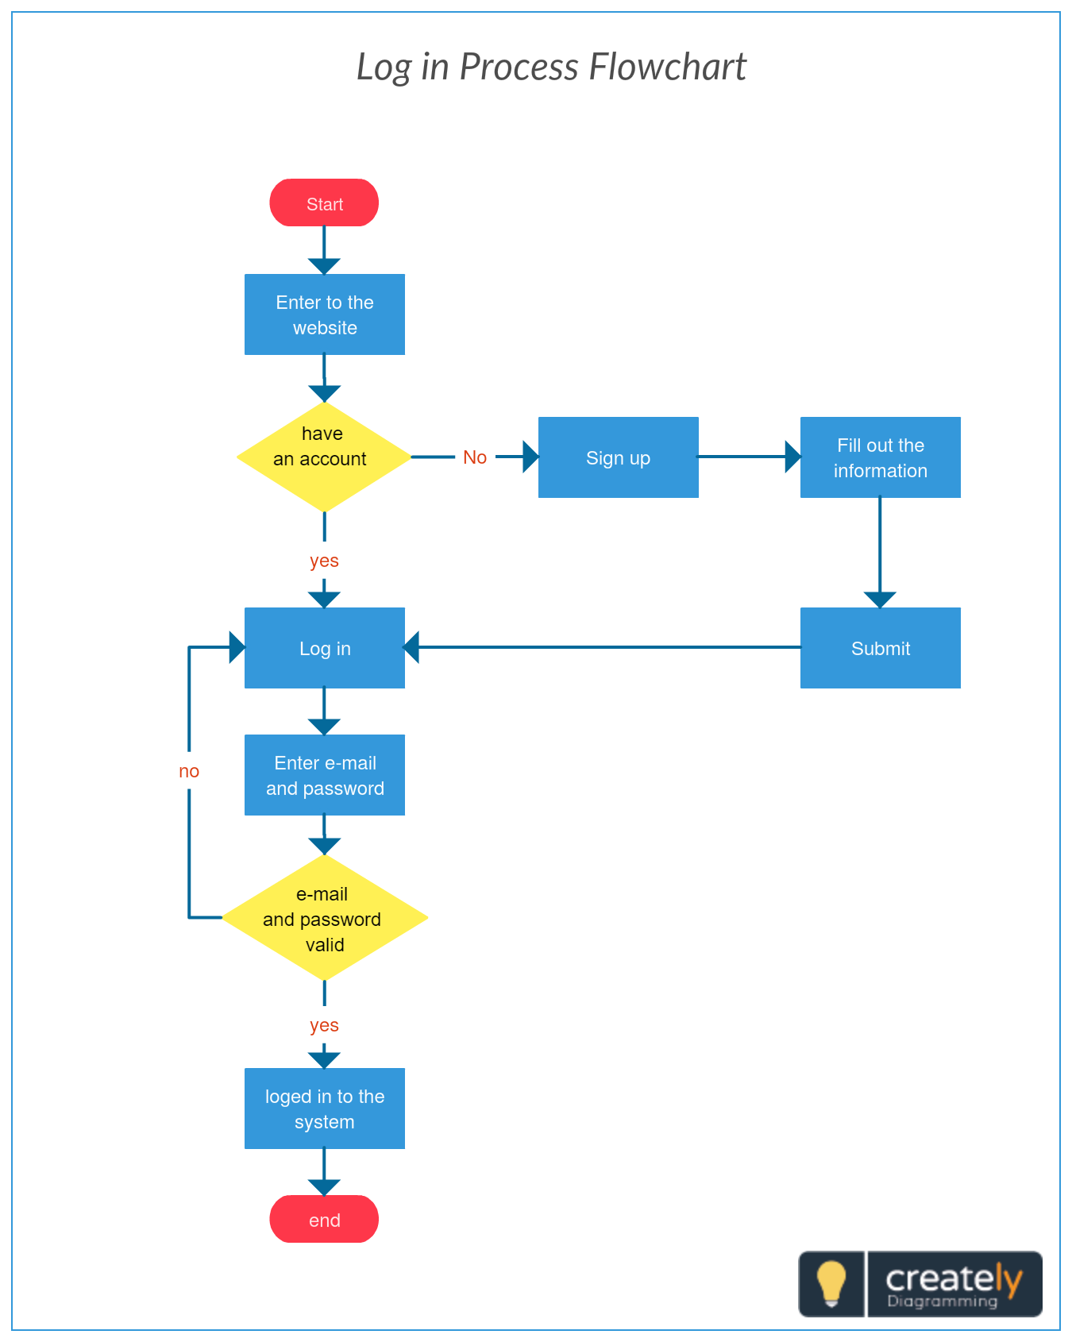
Flowchart

Slide 6
Project Modules
The two main users involved in this system are
User (i.e. Students)
Admin

Slide 7
Admin
Dashboard: In this section, admin can see all detail in brief like Total Classes, Total Students, Total Class Notices and Total Public Notices.
Class: In this section, admin can manage class (Add/Update/Delete).
Students: In this section, admin can manage the students (Add/Update/Delete).
Notices: In this section, the admin can manage notices (Add/Update/Delete).

Slide 8
Public Notices: In this section, the admin can manage public notices.
Pages: In this section admin, can manage about us and contact us page of administration
Search: In this section admin, can search students by their student id.
Reports: In this section admin, can view how much students has been register in particular period.
Admin can also update his profile, change the password and recover the password.

Slide 9
Users (Students)
Dashboard: It is welcome page for students.
View Notices: In this section, user can view notices which are announced by administrator.
Student can also view his profile, change the password and recover the password.

Slide 10
User (Non-Register)
Home: It is welcome page for user.
About: User can view about us page.
Contact: User can view contact us page.

Slide 11
Features of Student Management System
The SMS offers a wide range of features to help educational institutions streamline their operations. One of the key features of the system is the ability to manage student records, including personal information, academic history, and attendance records.
Other features include automated grading systems, class scheduling, and online registration. The system also provides real-time reporting, allowing administrators to monitor student progress and identify areas that need improvement.

Slide 12
Benefits of Using Student Management System
The SMS offers several benefits to educational institutions, including increased efficiency, improved communication, and better decision-making. By automating many of the administrative tasks, the system frees up time for teachers and administrators to focus on other important tasks.
Additionally, the SMS provides a centralized platform for communication between teachers, students, and parents. This improves transparency and reduces the likelihood of miscommunication. Finally, the system provides valuable insights into student performance, allowing educators to make data-driven decisions about curriculum and instruction.

Slide 13
Challenges in Implementing Student Management System
Implementing a student management system can be a complex process that requires careful planning and execution. One of the main challenges is ensuring that the system integrates seamlessly with existing infrastructure, such as learning management systems and student information systems.
Another challenge is ensuring that the system is user-friendly and accessible to all stakeholders, including teachers, administrators, students, and parents. Finally, ensuring data privacy and security is also a critical concern, given the sensitive nature of student information.

Slide 14
Conclusion
In conclusion, the Student Management System is a powerful tool for educational institutions to manage their student-related data efficiently. By automating many of the administrative tasks and providing real-time reporting, the system can help improve efficiency, communication, and decision-making.
However, implementing the system can be a complex process that requires careful planning and execution. By following best practices and addressing the challenges involved, educational institutions can ensure a successful implementation and maximize the benefits of the SMS.

